Slide 1
Understanding the popularity of reporters and assignees in the Github

Slide 2
Understanding the popularity of reporters and assignees in the Github
Joicy Xavier, Autran Macedo, Marcelo Maia
Computer Science Departament
Federal University of Uberlandia
Uberlandia, Brazil

Slide 3
Agenda
Introduction
Goal
Methodology
Results
Final Remarks

Slide 4
Introduction
Nowadays, large volumes of data are available the most different ways.
Many of these data may be in data repositories.
Extract relevant information from these repositories is a major challenge.
In the software development scenario, the situation is similar:
Ohloh.net: near 30 billion stored lines of code in February, 2014;
Web 2.0 phenomenon: has influenced how software engineers manage projects;
Collaboration: has been considered a key success factor for the software lifecycle;
Service providers: has been offering more support for software development collaboration.

Slide 5
Introduction
Classical repository with version control has been lost ground for more sophisticated services (e.g. issues trackers and collaborative code review).
Intricate relationships manifest in the different artifacts produced during the development process.
How to identify these relationships?
Mining software repositories plays a key role in this case.

Slide 6
Goal
Github is a major service provider for project hosting, containing:
source code and respective commits;
life cycle of issues;
events raised from the collaboration among their users.
Users on Github:
Reporters: report the issues;
Assignees: fix known bugs;

Slide 7
Goal
Different user profiles may induce different collaboration patterns and consequently different popularity profile.
It is important to understand different patterns and profiles in this collaboration process in order to improve our behavior as a community.
This paper analyze the behaviour of users that typically report bugs and of users that typically fix bugs of roles using a partial dataset from selected projects of Github.

Slide 8
Methodology
Dataset Github:
90 projects;
150,000 issues;
13 different programming languages.
We considered:
Issues that were associated to bugs (56,959 issues).

Slide 9
Methodology
Steps:
We selected issues related to bugs.
For each user associated to issues, we computed:
how long time the user has been registered in the Github (Time),
number of followers (Followers),
total number of commits in all participating projects (Commits),
number of collaborating projects (Projects).
Data analyzed usig Weka¹
Association rules with minimum support equals to 0.1 and the minimum confidence greater equals to 0.4.
¹ www.cs.waikato.ac.nz/ml/weka/index.html

Slide 10
Methodology
TABLE 1: Ranges Used in the Data Analysis
Time | Followers | Commits
0-1 years | 0-50 | 0-100
1-2 years | 50-100 | 100-300
2-3 years | 100-150 | 300-500
3-4 years | 150-200 | 500-1000
+4 years | +200 | +1000

Slide 11
Results
Reporters
Assignees
Mining relationships on user variables

Slide 12
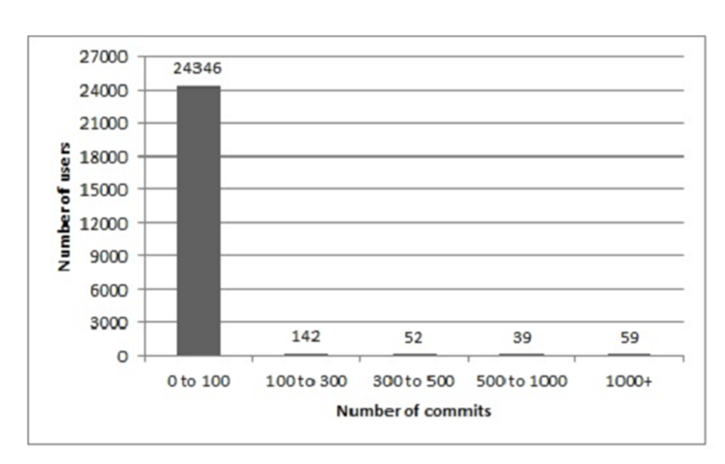
Reporters
Reports do not necessarily need to commit;
The large majority of the reporters (24,346) have small number of commits (0-100).
Fig. 1. Number of reporter commits

Slide 13
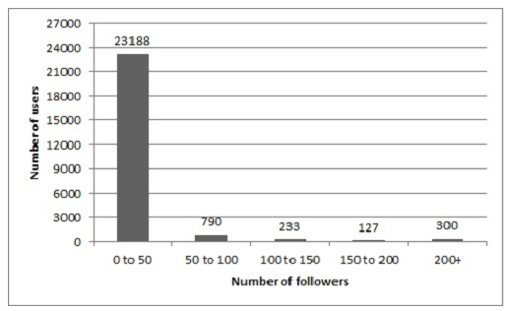
Reporters
The most of reporters (94.11%) have small number of followers (0-50).
There are some reporters that are intensively followed, but only 5.88% have more than 50 followers.
Fig. 2. Number of reporter followers

Slide 14
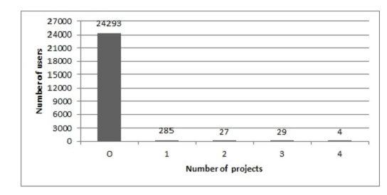
Reporters
24,293 reporters (98.6%) participate in zero project.
It is possible to report a bug without being attached to the respective project.
Fig. 3. Number of projects reporters participate

Slide 15
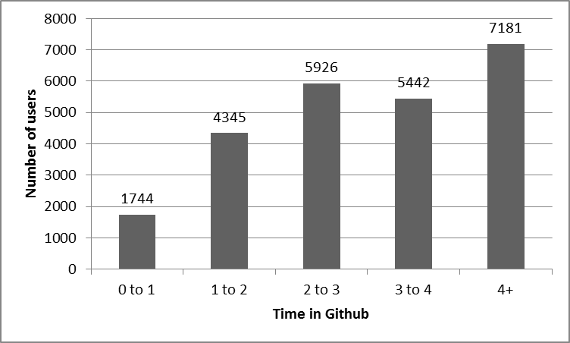
Reporters
The period of time that the reporters are registered in Github varied from 72 days to six years.
A significant part of the users have been registered for more than four years.
Fig. 4. Registration time for reporters

Slide 16
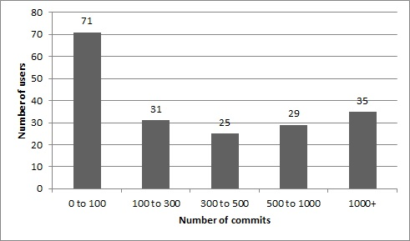
Assignees
Assignees are the users who fix bugs.
From the 56,959 bugs, only 4,425 had an associated assignee.
The predominant range for assignee commits was zero to 100.
There is a considerable number of very active assignees (those with more than 1000 commits).
Fig. 5. Number of assignee commits

Slide 17
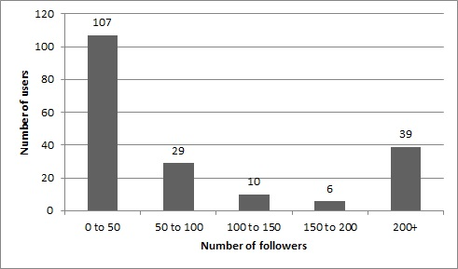
Assignees
56% of users (107) have from zero to 50 followers and 20% (39 users) have more than 200 followers.
The ranges with higher number of followers have much more higher relative frequency for assignees than for reporters.
Fig. 6. Number of assignee followers

Slide 18
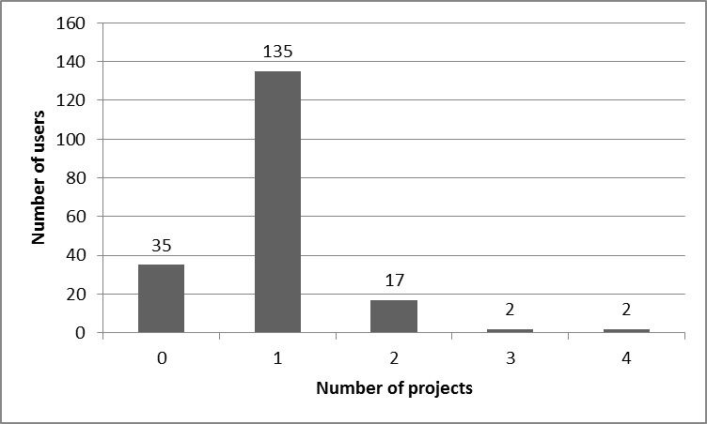
Assignees
The most of assignees (135 = 70.6%) participate in at least one project.
Only 1% of reporters participates in at least one project.
Fig. 7. Number of projects assignees participate

Slide 19
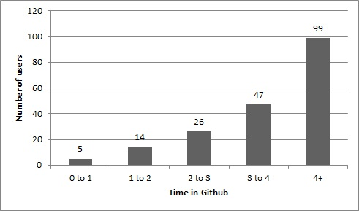
Assignees
51.8% of the assignees are registered for more than four years and only 2.6% are registered for less than one year.
The larger the registration time, the large is the user contribution in the fixing of bugs.
Fig. 8. Registration time for assignees

Slide 20
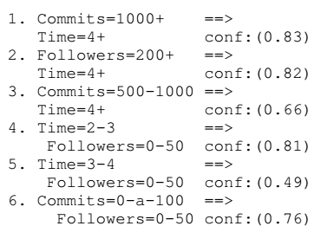
Mining relationships on user variables
We use association rules to find possible relationships between the activity of users in the repository.
Reporters are typically users with low activity, independently of the registration time.
Assignees tend to have a larger registration time and to be more active and popular.
Users with low number of commits tend to have low number of followers (rule 6).
Fig. 9. Association rules

Slide 21
Mining relationships on user variables
Manual inspection the users with the highest number of followers to identify other factors that could promote their popularity:
We have filtered in the +200 commits range, those users with more than 1000 commits.
Found 34 users:
20 - only reporters
14 – reporters and assignees

Slide 22
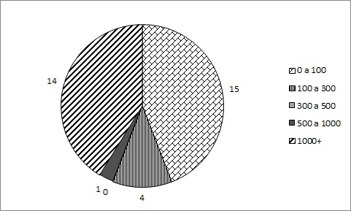
Mining relationships on user variables
The number of commits has divided the set of users with more than 1000 followers into two predominant subsets:
Users with more than 1000 commits.
Users with less than 100 commits.
Although the commit activity can help to achieve the highest levels of popularity, it is not necessarily the major factor.
Fig. 10. Number of commits for users with +1000 followers

Slide 23
Mining relationships on user variables
15 popular users that have a few committers
4 are owners of important projects: html5 - boilerplate, jquery, homebrew and rails.
We could not find in the dataset information that could help to explain the high popularity of the other 11 users.
Activity of those users outside the Github:
Participation in the web with blogs and personal social network
Publication of printed books
One of these users did not fix any bug, is not a project owner, follows just a few users, and has more than 2000 followers. However, this user writes blog, acts in several social networks and is a book author.

Slide 24
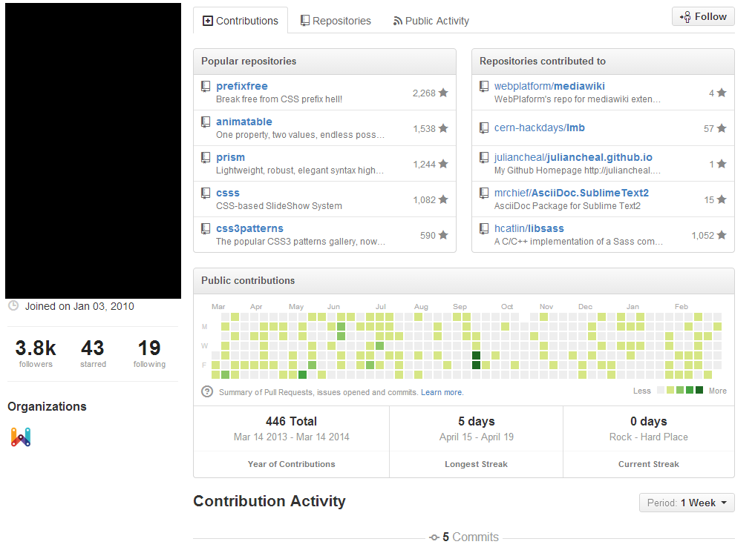
Mining relationships on user variables
Example:
User with low activity.
More than 3,000 followers.
However, he founded a blog.
He have a high activity in social networks.
Fig. 11. An example of user with +1000 followers and <100 commits

Slide 25
Final Remarks
The number and the profile of reporters and assignees are quite different:
Assignees have more specialized activity their are present in lower number;
Reporters are users with relative lower registration time because they can more easily contribute in bug detection.
The commit activity may influence on the popularity.
Other factors outside the Github activity also influence the popularity.
The popularity outside the Github is likely important to improve the popularity inside the Github and should be considered as an important factor to the project success.

